Slide 1
ENSE 374, Milestone 3
13/11/2019
Daniel Takyi
Jiwoun Kim
Mason Lane

Slide 2
Team: They Will
We’re creating a web-app that provides random venues for a user to explore.
People should be able to garner a random list of curated results after entering various search parameters.
This application will grant users the opportunity to discover and enjoy new experiences by suggesting random food locations. It will help the indecisive make quick novel decisions, or simply grant the experimental types new adventures to behold.
https://github.com/jiwoone/ENSE-374-Project.git

Slide 3
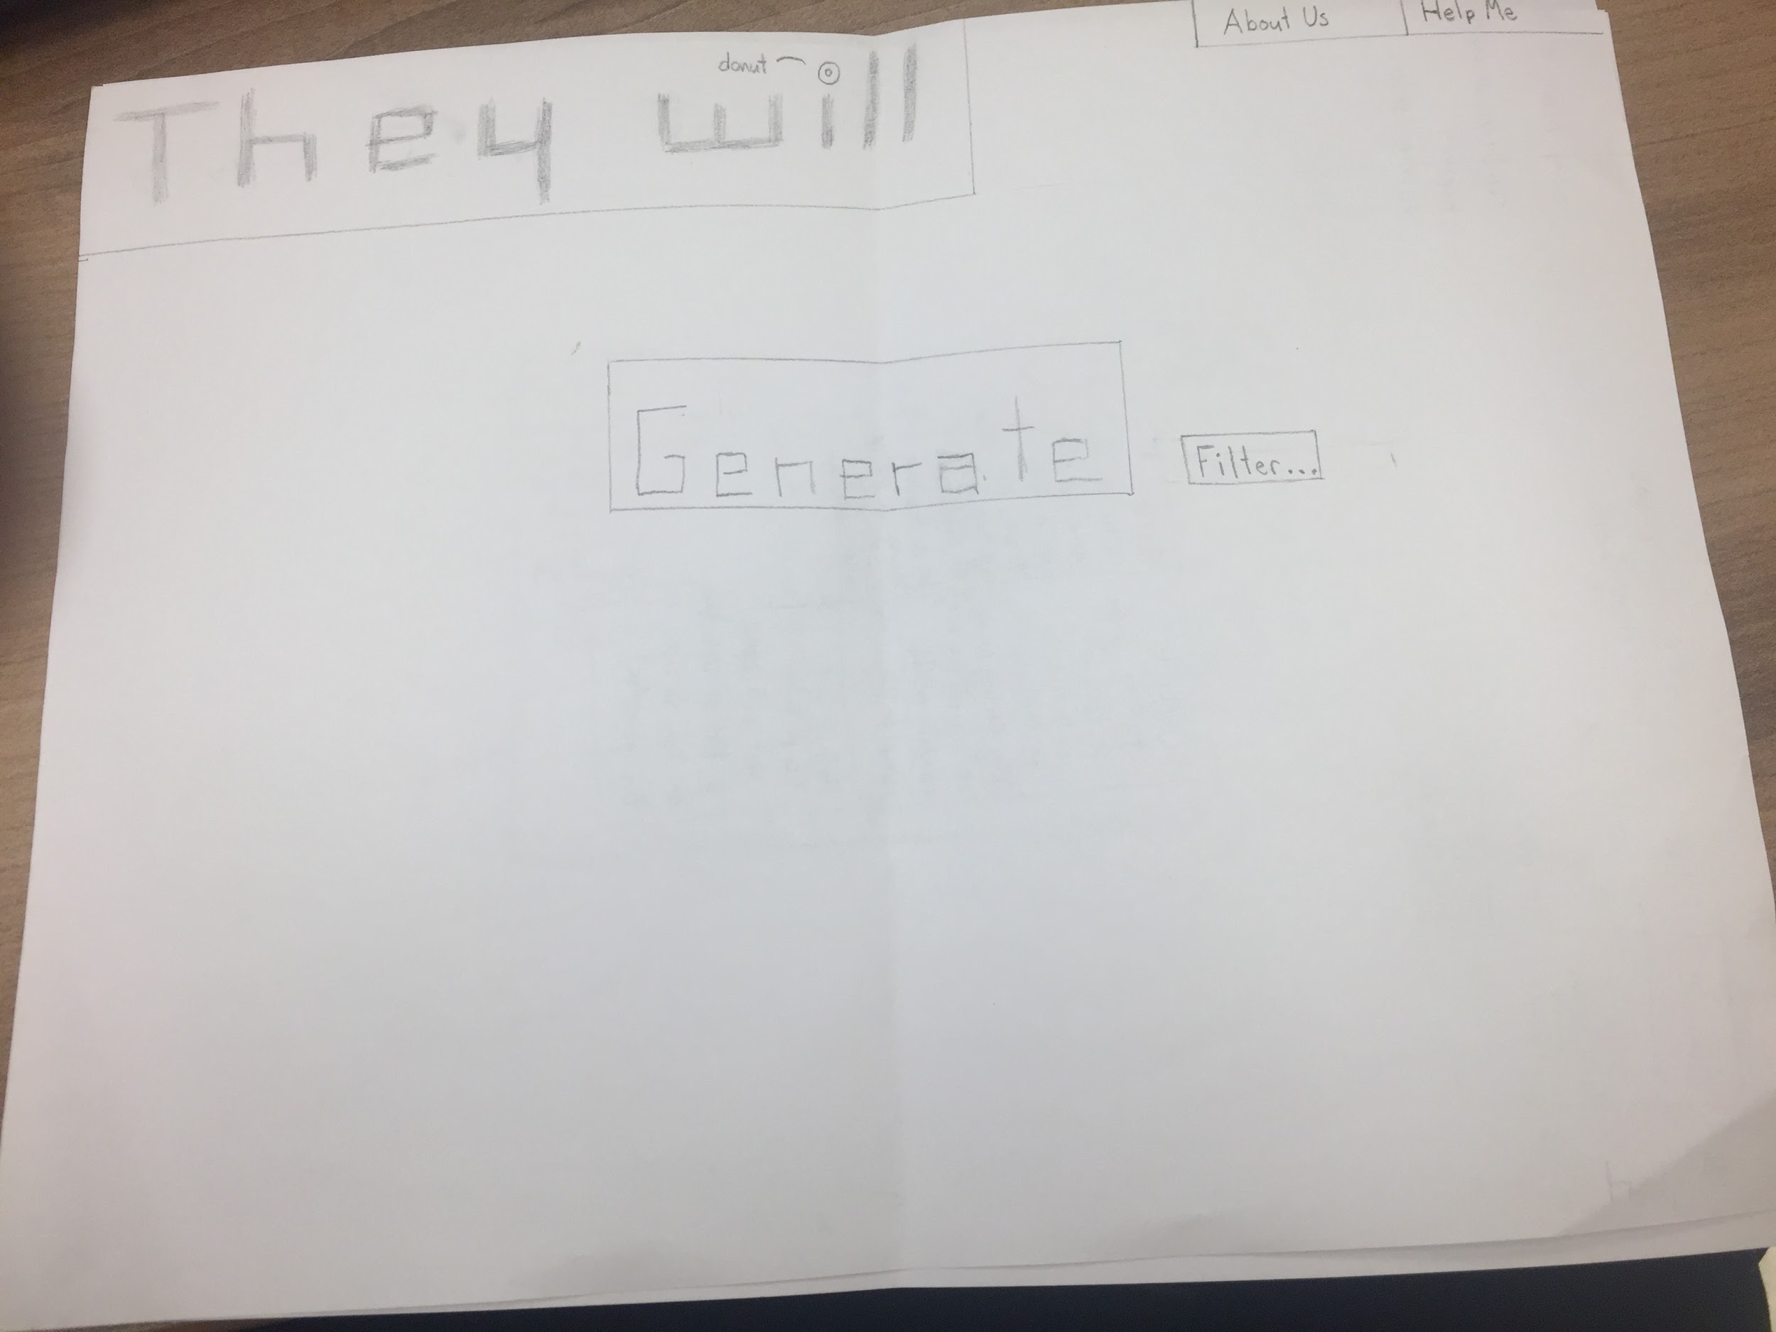
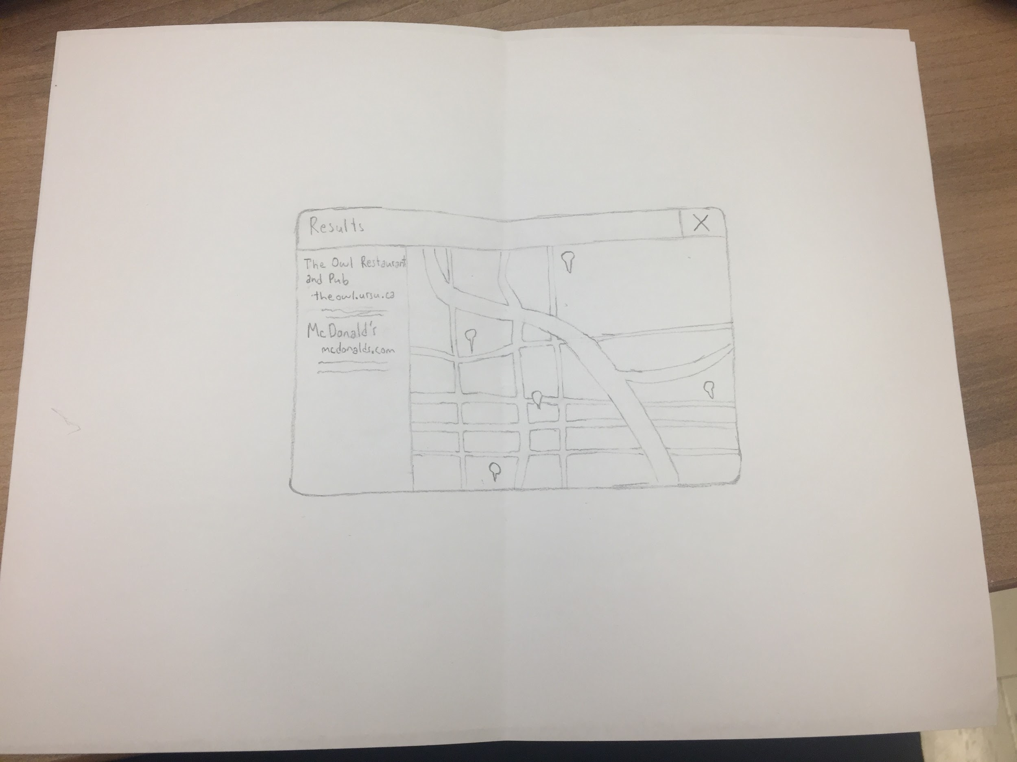
LoFI Prototype
Main Page
Results Page

Slide 4
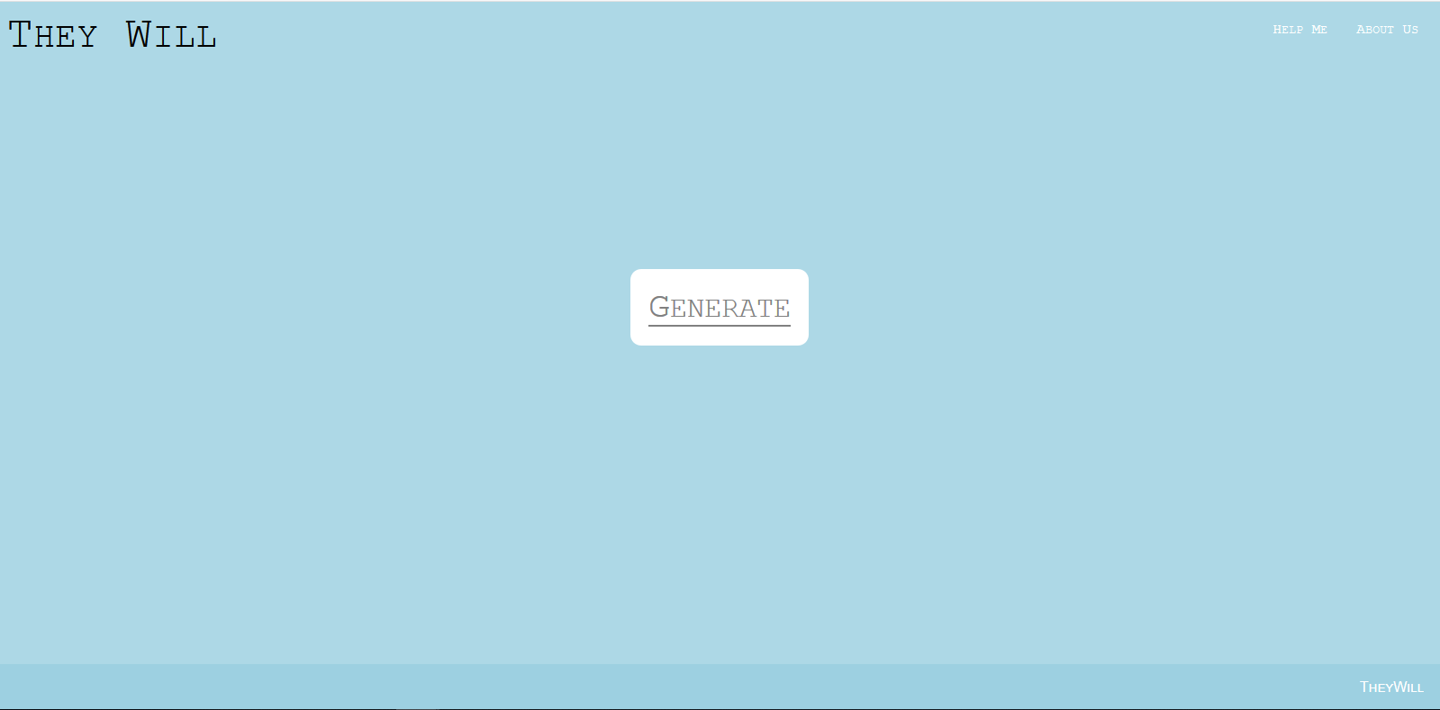

Slide 5
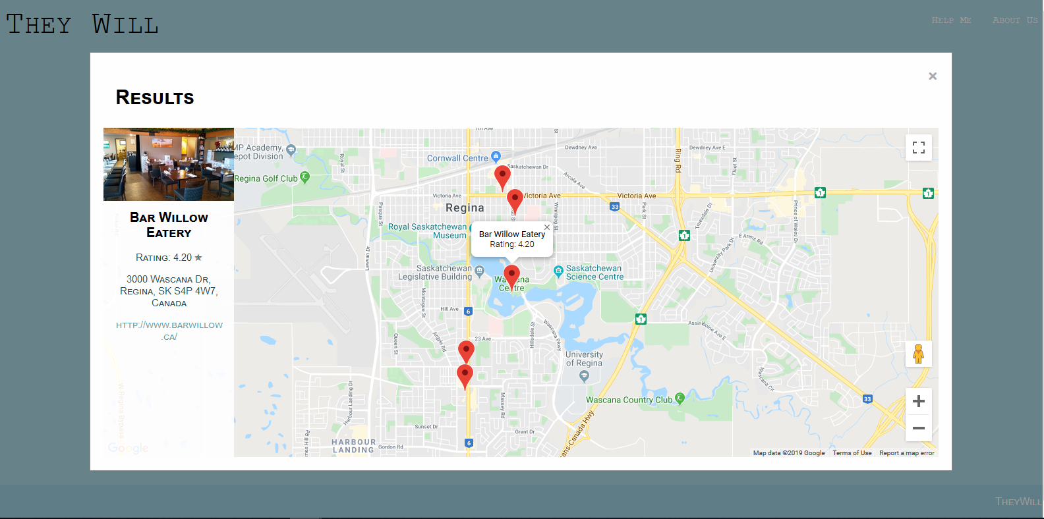

Slide 6
MVP 1 In Review
Achieved the majority of planned results
We are missing a list displaying all 5 locations for a user to easily recognize and click
Users must click on each individual marker (not good).
MVP can fulfill user needs based on provided user stories however...
Questionable reliability
UI needs improvement
Search input settings would grow the scope of the app’s abilities
*Code Review* 👏👏
Clean code, ugly variables. We should consider organizing and renaming some of our variables for future use.
May also gut a large portion of the maps/panel code. Split .JS file into multiple files, conforming with MVC architecture.
Split larger methods into smaller, modular components

Slide 7
FRD Update
API privacy concerns :(
Our user’s privacy is currently safe - ours is not
Anyone may feasibly find and use our API key
We can support 4500 requests a month before Google begins charging a fee for traffic
If we want to avoid paying, we need to
A: limit traffic
B: Prevent others from seeing/using our API key
Updated several diagrams

Slide 8
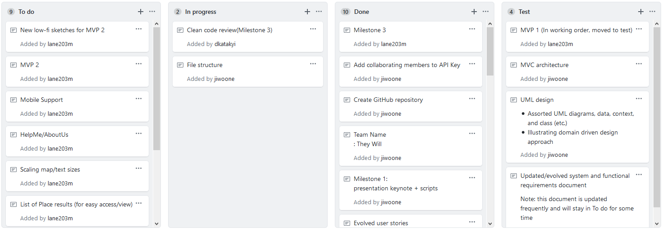
Kanban
https://github.com/jiwoone/ENSE-374-Project.git
https://github.com/jiwoone/ENSE-374-Project/projects/1

Slide 9
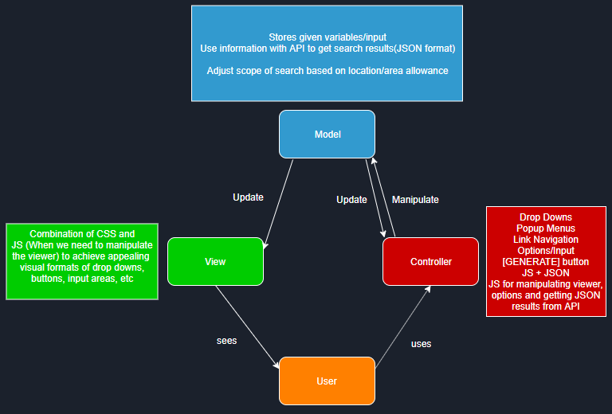
MVC

Slide 10
Class Diagram
PlaceDetail
place_name: string
place_Id: string
request
-Description: string
-operationTime: Date() -phoneNumber: int
-priceRange: int
-menu: string
-recentReviewArticle: string
-overallRatings: int
placeSearch
-lng: double
-lat: double -locationType: string
-searchRadius: int
-searchSize: int
<<get search results>>
<<get details>>
1:*
1:*
-name: string -formatted_address: string
-geometry: string
-rating: int
-website: string
-photos
1:*
/* We can get the longitude and latitude by using a javascript function. However, the browser might not support it. Then we use searchText option for user could type the city or the location manually. */
/* if the place has own website, url will be the website address. Url possibly does not exist. */
<<get menus information>>
MenuList
-menu: string
-rating: int
/* possibly no menu information for a place */

Slide 11
MVP 2 - Looking Forward
We plan on implementing:
An interactable list is our main priority to start
Form input/validation - may limit user’s options to preset alternatives instead
Looking to make the map size horizontally scalable
Working “HelpMe” and “AboutUs” pages
Hidden/secure API key. Traffic allowance to prevent request charges
New Lofi sketches and implementation as we improve our UI.
Updated Lofis for our form input, etc.
Mobile testing
These are the most important deliverables and appears doable.
Our understanding of the data coming from the API has grown substantially - so development should run smoother.
Current barriers:
Our interactable list is difficult to implement in conjunction with the map markers. Form input may not “play nice” with our API requests

Slide 12
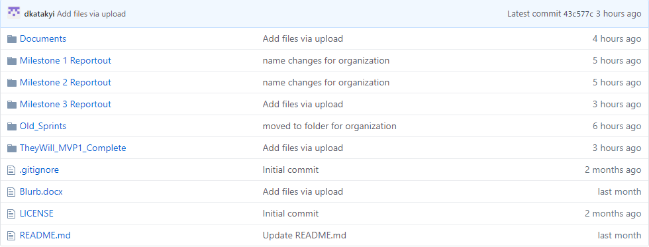
GitHub
https://github.com/jiwoone/ENSE-374-Project.git

Slide 13
Group reflection
•How did you feel about this milestone? What did you like about it? What did you dislike?
•Our deliverables felt like they had substance - it was nice implementing our concepts. It did feel very rushed.
•What did you learn about yourself as you collaborated and worked through this milestone?
•It was hard staying in one area (model, view or controller), and we often worked in each-other’s domain.
•How will you use what you have learned going forward?
•We have grasped how to effectively communicate with the Google Places API using our key, and will hopefully see our development speed increase as we’ve established this foundation.
•What “stuff & things” related to this milestone would you want help with?
•How do we secure the privacy of our API key. This is a serious concern if we truly put our app on the internet.

